Slide 1
Login/Signup
About Us
Shop
Contact Us
EASY 3D
WE PUT THE EASY IN 3D, SO YOU CAN FOCUS ON CREATING, NOT CALIBRATING.
CEO
Nathan Pugh

Slide 2
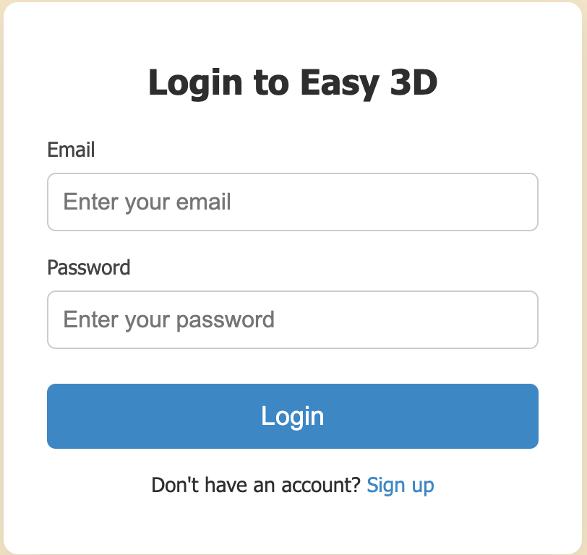
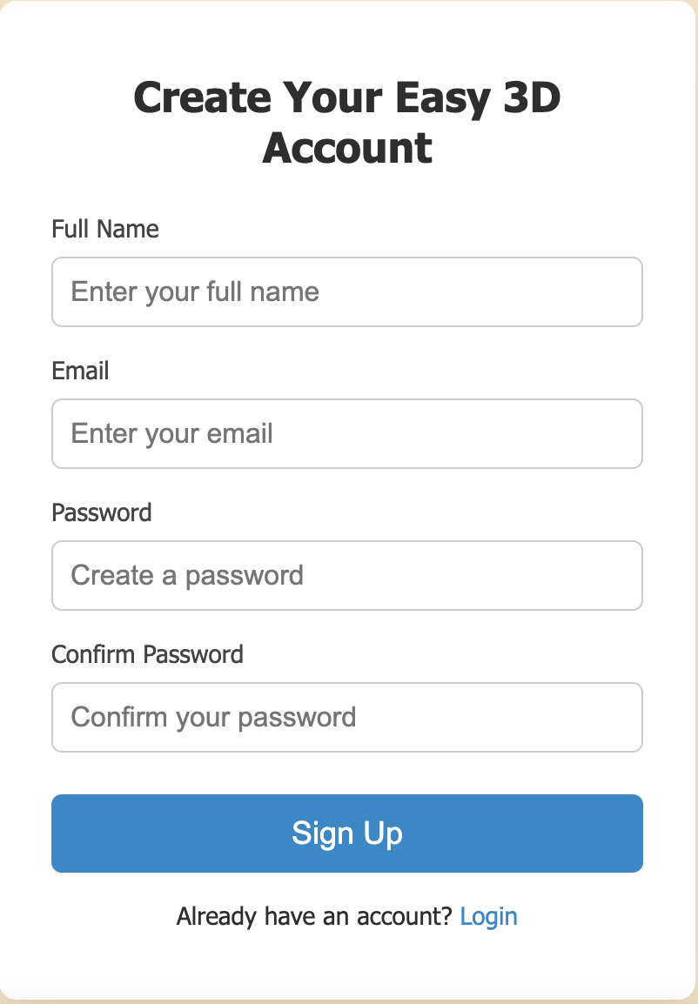
Login/Signup

Slide 3
Table of Contents/Navbar & Hoverble Dropdown Menu
About Us
3
Our Mission
4
Our Goal
5
Shop
7
All Products
8
Custom Designs
9
Contact Us
10

Slide 4

Overview
About Us
Problem
The high costs of owning and maintaining a 3D printer
Role
Production Partner
Technical Expert

Slide 5

Our Mission
Mission Statement
At Easy 3D, we make rapid prototyping and custom part production accessible and affordable. Our mission is to empower creators, makers, and businesses to bring their ideas to life through high-quality 3D printing services eliminating the barriers of traditional manufacturing with fast turnaround and tailored solutions.

Slide 6

Our Goal
Our Goal
“We put the easy in 3D so you can focus on creating, not calibrating.”
Our Goal
At Easy 3D, our goal is to remove the technical and financial barriers that often prevent creators, educators, and entrepreneurs from accessing high-quality 3D printing. We take care of the complex, time-consuming tasks like calibration, material selection, and print optimization so our customers can stay focused on what truly matters: designing bold ideas, solving real-world problems, and bringing their visions to life without distraction.

Slide 7

Our Goal
Shop
Featured Products

Slide 8

All Products / Custom Designs
Entry
Welcome
Select Task
Task 1
Correct?
Details
Find
Items Not Found
Search Items
Order
LEave

Slide 9
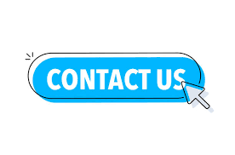
Contact Us
Our Goal
Contact Us
Phone:
Instagram:
Email:
Website:

